Slide 1

EE5415 Presentation
Wallet Keeper(钱包管家)
Group: 15
Members: Fang Yuxin (55941269)
Li Huimin (55997947)
Shen Yaojun (55988822)
Zhang Jianing (55831831)
Zhou Ziyang(55921210)
Notes:
Good afternoon everyone, it’s glad to introduce our app “Wallet Keeper” to you all, and it’s Chinese name is 钱包管家，which contains a wish that after using this app, you can balance your income and expenses.

Slide 2

Comment:
Story
Functions
Basic functions
Bookkeeping
Recording
Graphical analysis
Special function
Wish list
Demonstration
Conclusion
Notes:
Our presentation has 4 parts, the first part is the story of wallet keeper, the second part is the function of this app, which includes three basic functions of bookkeeping, recording, graphical analysis and a special function wish list, and the third part is demonstration, finally, we will get a conclusion.

Slide 3
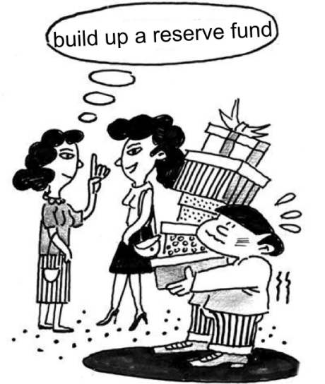




Story
Notes:
First, I will introduce the story of our app. Nowadays, our youth, have a high enthusiasm for new consumption methods and concepts, that mean we no longer pay attention to the balance of bills, and even over-spend. Alipay, wechat pay, and credit cards, we have so many payment methods, if we are not sensitive about our every payment, we will get into trouble. Actually, we can see some people, at the end of each month, having difficulty to repaying the ant credit pay（花呗). In order to help people like them, we design a simple and convenient app wallet keeper, which can record every payment and make people sensitive about their spend, even help them to develop financial management concepts. next is the introduce of functions

Slide 4
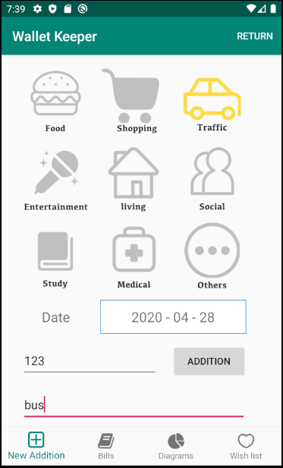
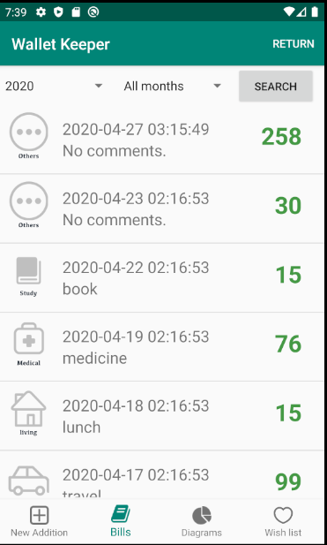
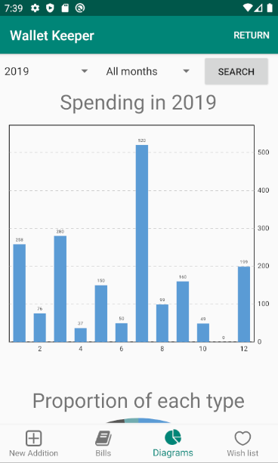
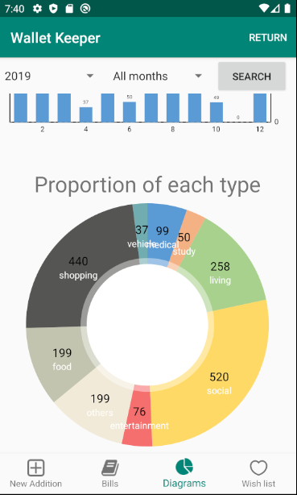
Basic functions
new addition
bills
Graphical analysis
Notes:
We designed three basic functions for this app including new addition, bills, and Graphical analysis in different user interfaces
In addition interface, we divided consumption into nine classifications, users can choose date and classifications for accounting.
In bills interface, users can check all past records on monthly or annually
In Graphical analysis interface, users can analyze their spending from pie chart or bar chart

Slide 5

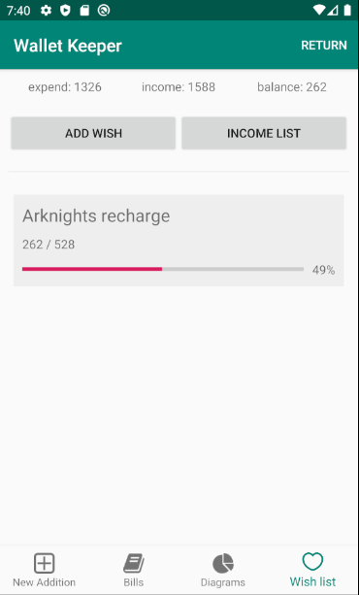
Special function
Notes:
Besides, we also add a special function called “wish list”. Users can set a target amount for something, and input their monthly income. This function will calculate users’ savings by minus total expenditure, then update progress bar.
Actually, we design this function aims to encourage people to stick bookkeeping, and then realize their little wishes. We all know that it is not easy to develop a habit, especially at the beginning,
So we hope with the encourage of the wish list, users can have the motivation, and develop the bookkeeping habits.

Slide 6
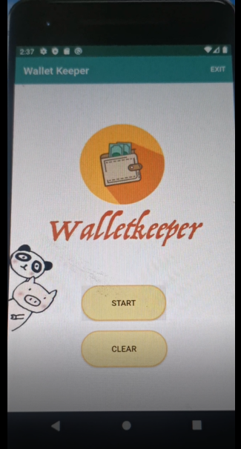
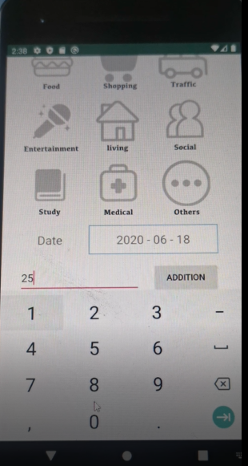
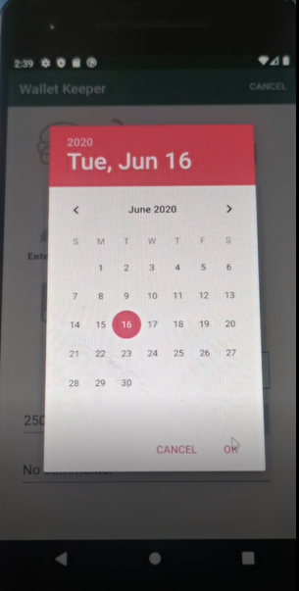
Demonstration:

Slide 7

Conclusion:
1) Multiple bookkeeping books.
2) Import bills from alipay in bulk.
Notes:
Although the major advantages of our app is its simplicity and ease of operation, we think there are still some areas worth improving.
As I mentioned in the picture,
First, we can devide Multiple bookkeeping books, which allows users to better distinguish different types of accounts, such as reimbursable parts and non-reimbursable parts, so that subsequent changes or deletion of accounts will be more convenient and can be operated in batches
Second, we want to implement the function of import bills from alipay in bulk. Now mobile payment is very convenient, especially Alipay, if you can directly import data from Alipay in bulk, you can save the user to manually add it more convenient.

Slide 8
THANK YOU
Wallet Keeper
Group 15

